Slide 1

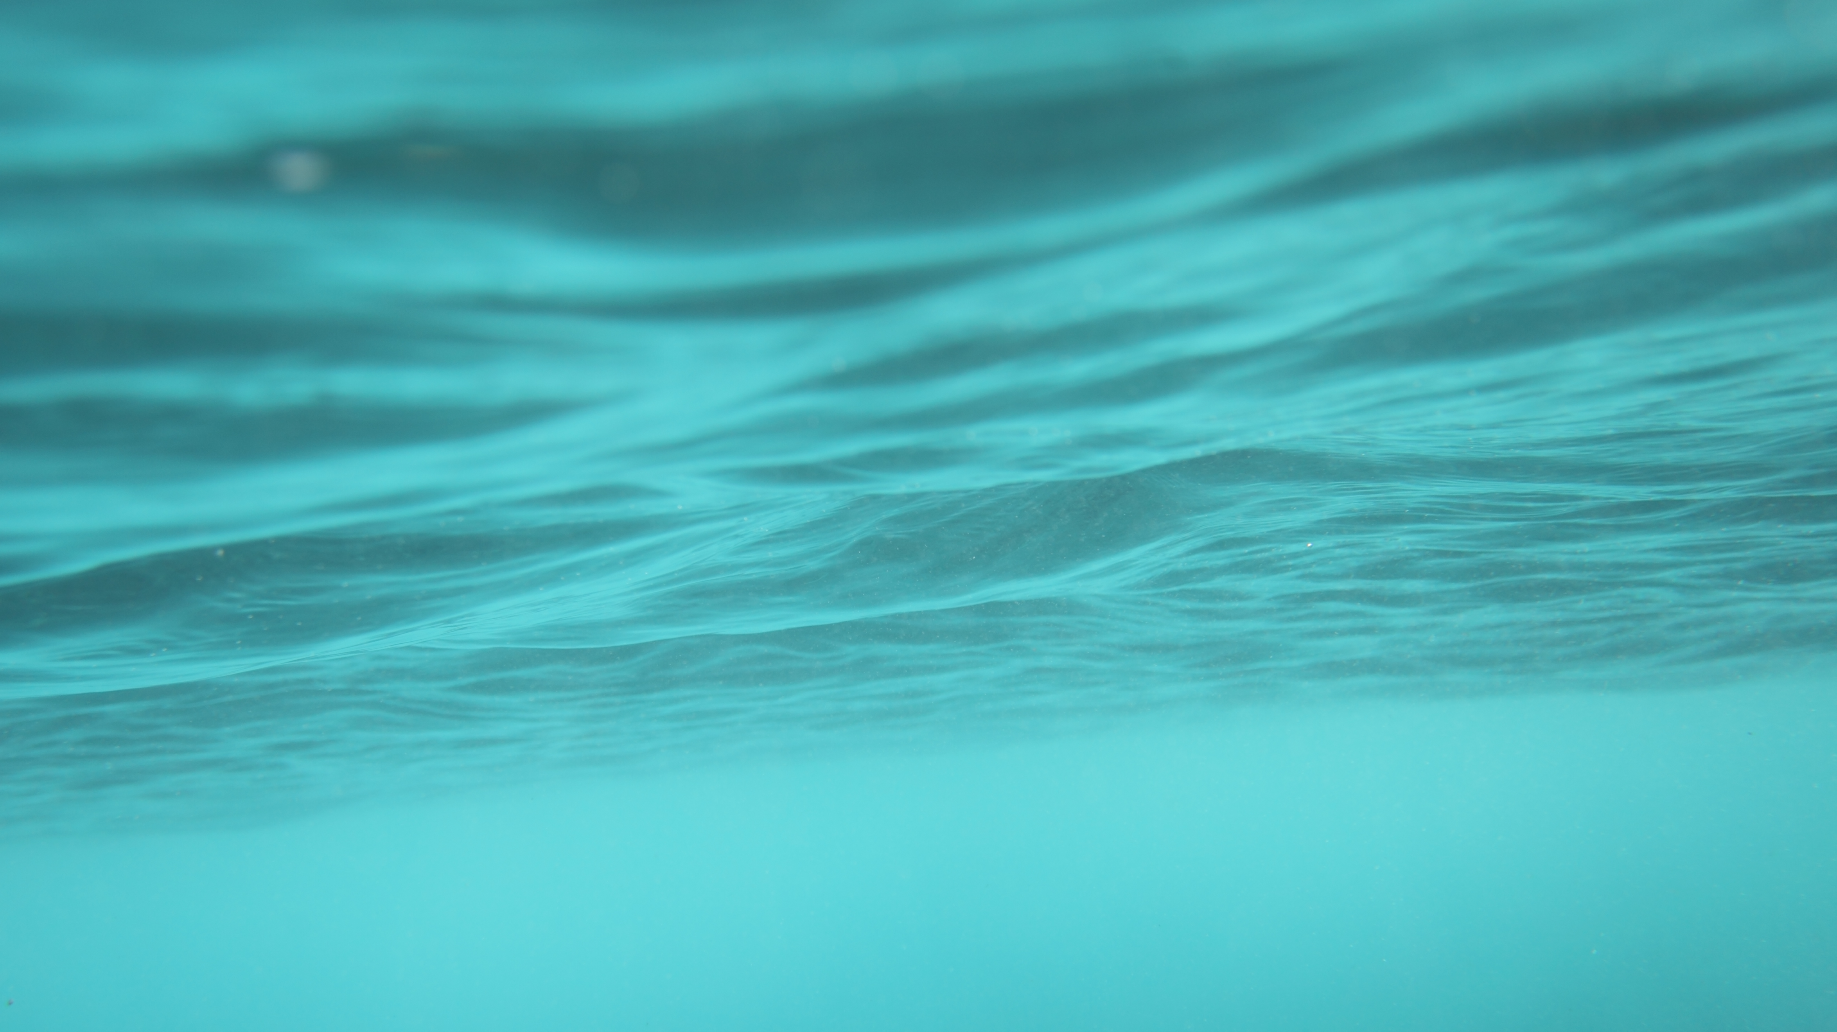
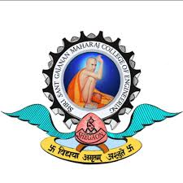
Shri sant Gajanan maharaj college of enginnering , shegaon .
Industrialvisit

Slide 2
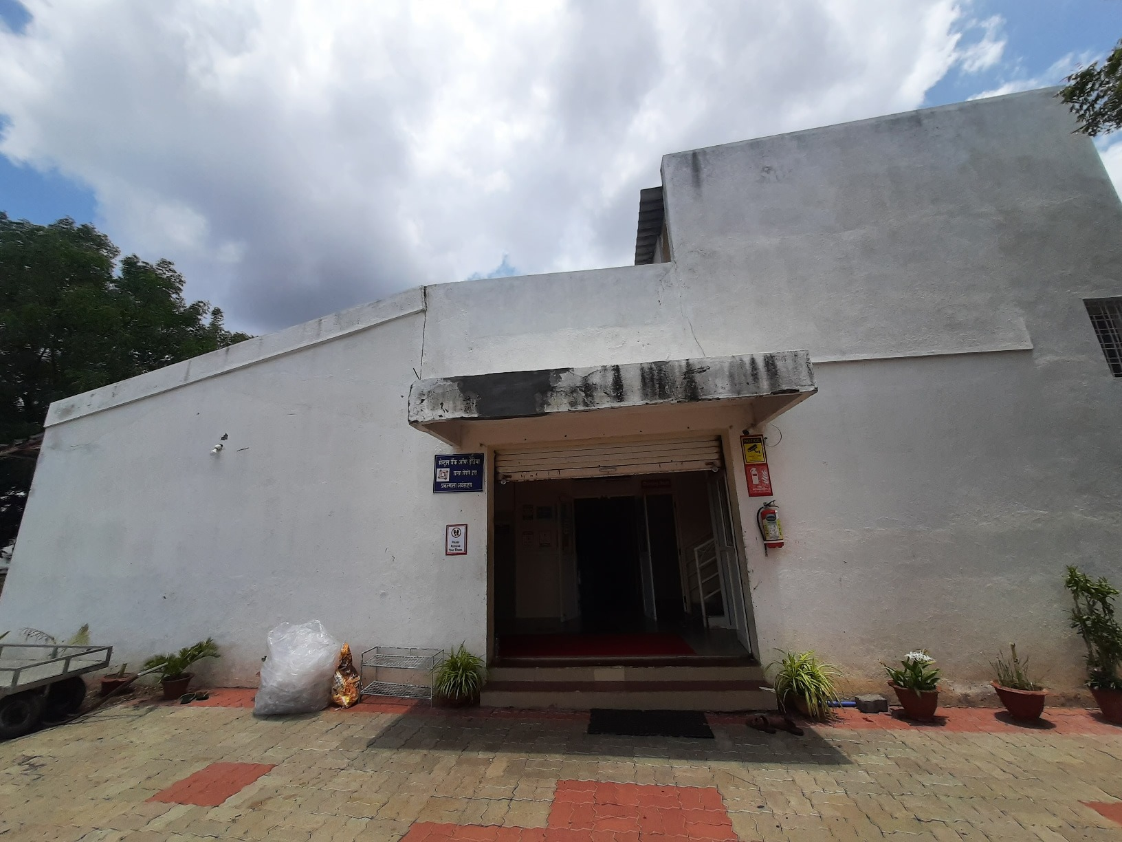
Bottle & Water Industry
VISITED TO :
Shri Krupa Logistic

Slide 3
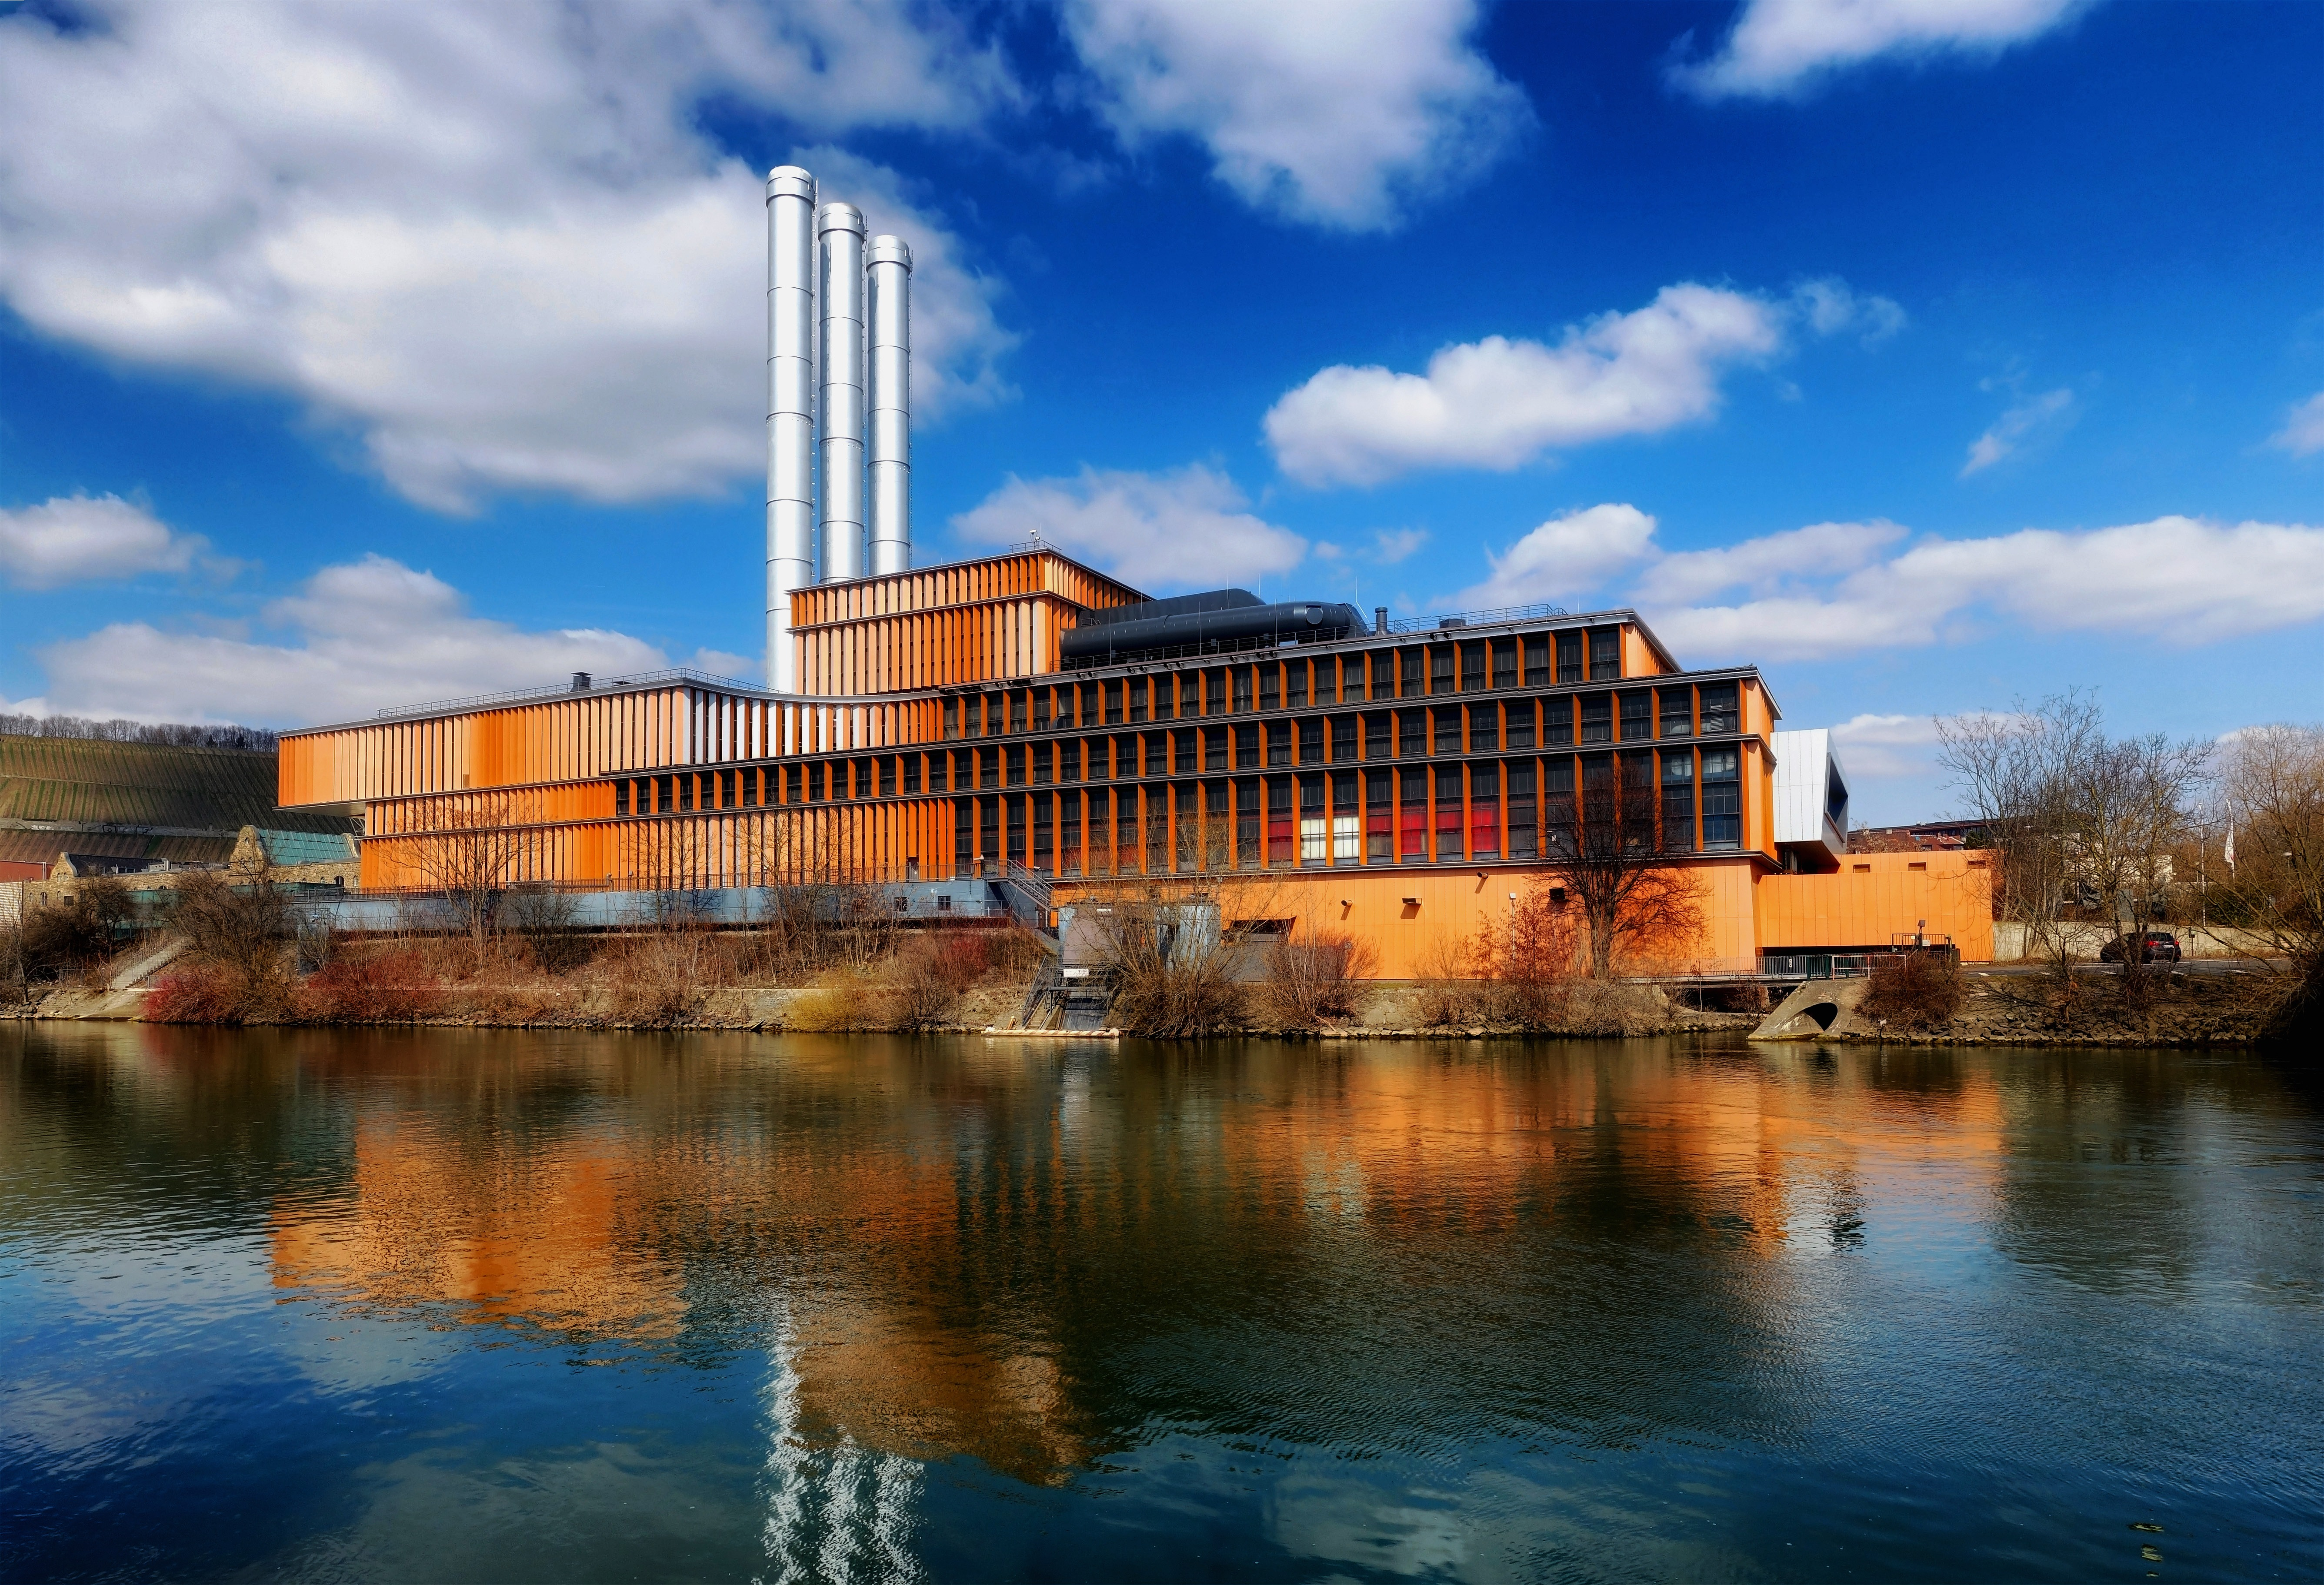
Area we visited in industry
Testing Lab
purification Area
Manufacturing Area
Water Filling Area
Labeling
Storage And Transportation

Slide 4
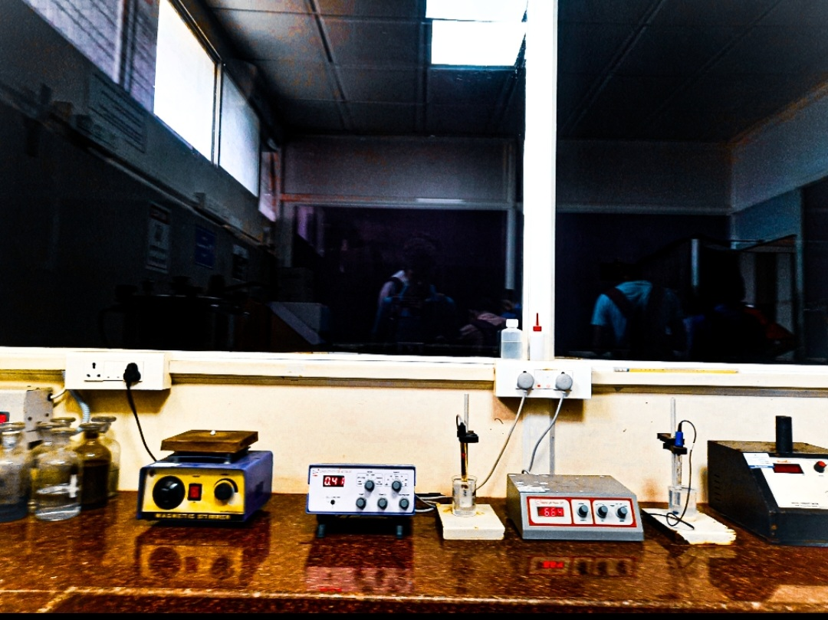
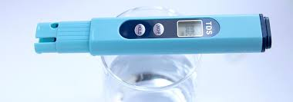
Testing Lab
Chemicals used for water testing
Chemicals that are used are for instance sodium chloride, potassium chloride, citric acid and chlorine dioxide.
TDS in Water (measured in PPM) | Suitability for Drinking Water
Between 50-150 | Excellent for drinking
150-250 | Good
250-300 | Fair
300-500 | Poor, not good for drinking

Slide 5
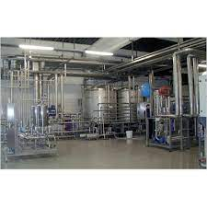
Purification Area
processes used to produce purified water: deionization, distillation and reverse osmosis.
But most of the Industry used Reverse osmosis Process.
This process including reduced cost and increased performance.

Slide 6
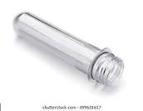
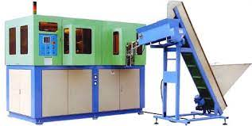
Manufacturing Area
A preform is an intermediate product that is subsequently blown into a polyethylene terephthalate (PET) container.
Products made from recycled plastic.

Slide 7
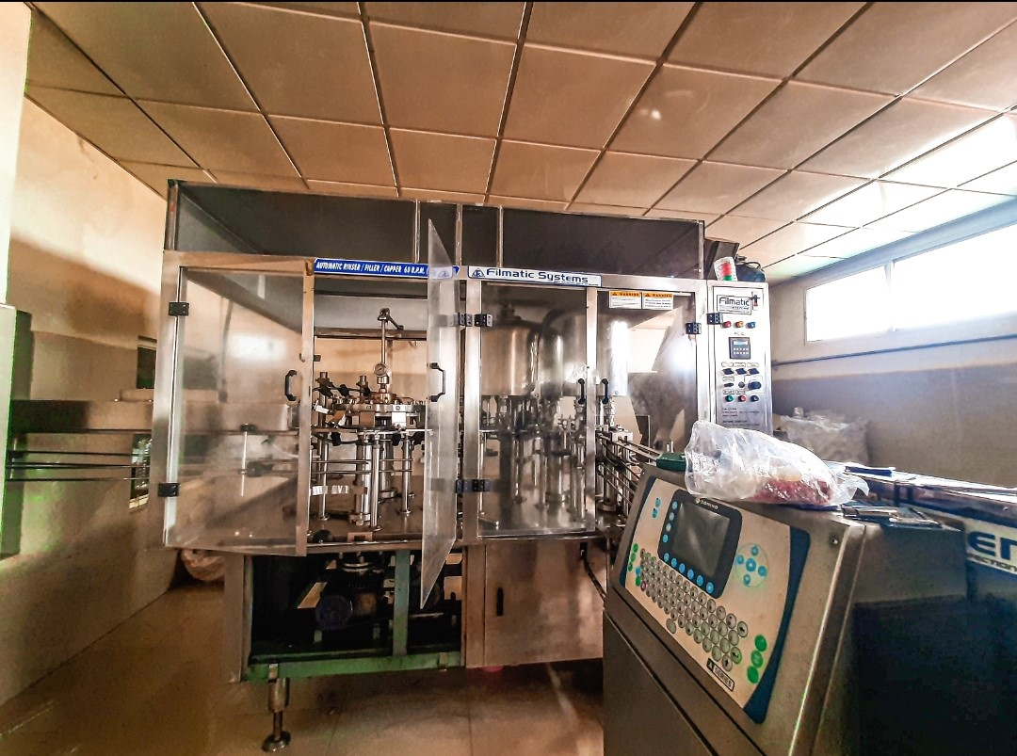
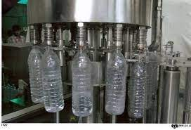
Water Filling Area
Here is the picture of Automatic Water Filling Machine

Slide 8
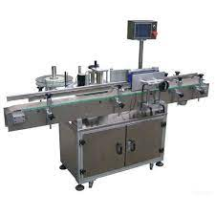
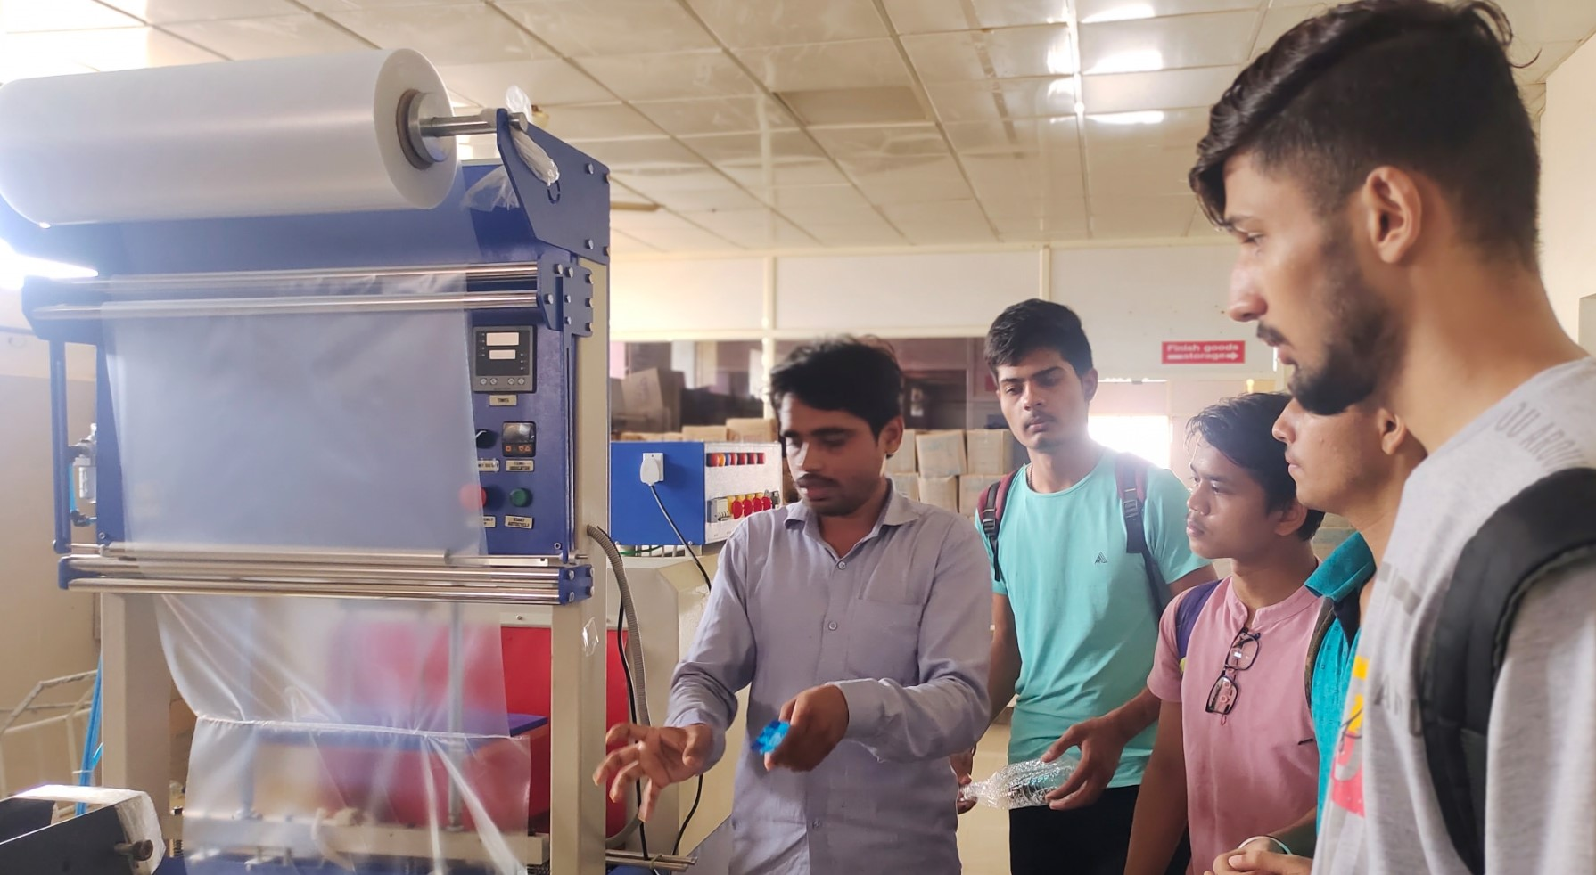
Labeling & Warping
Automatic Bottle Labeling Machine
Warping Machine
After filling the water
Bottle came for Labeling
After Labeling Bottles are directly came for Warping

Slide 9
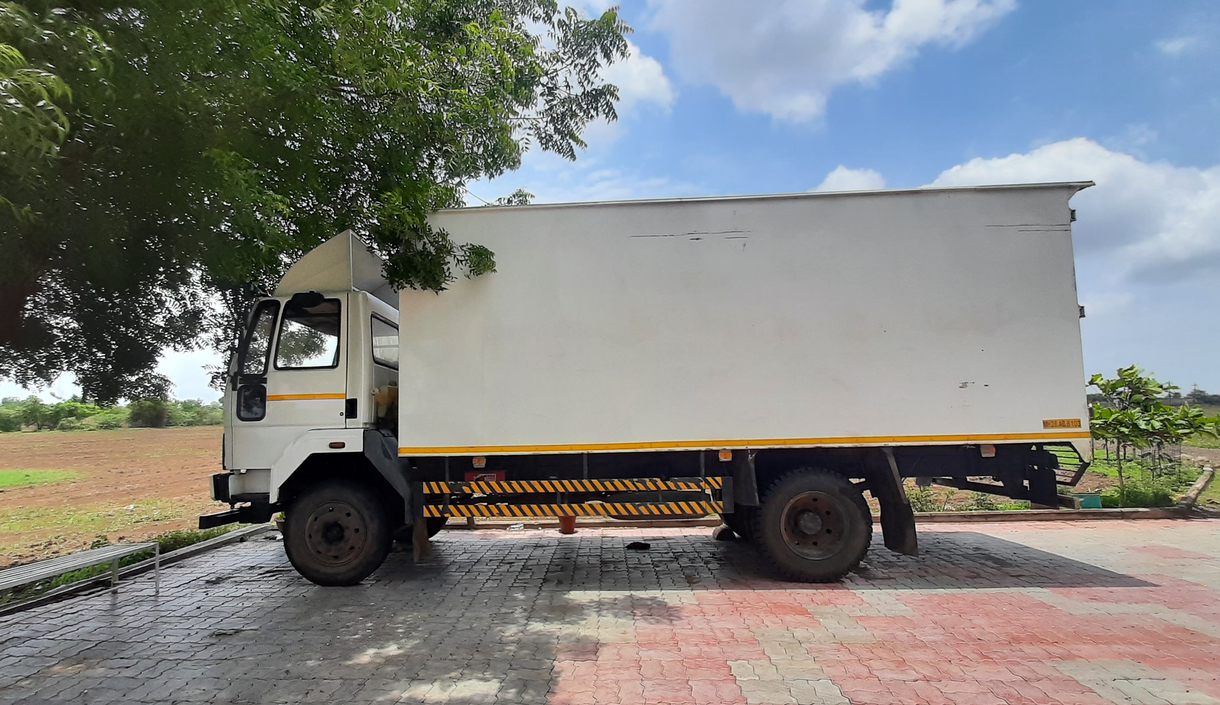
Storage And Transportation
Transportation of Bottles are widely done in summer

Slide 10
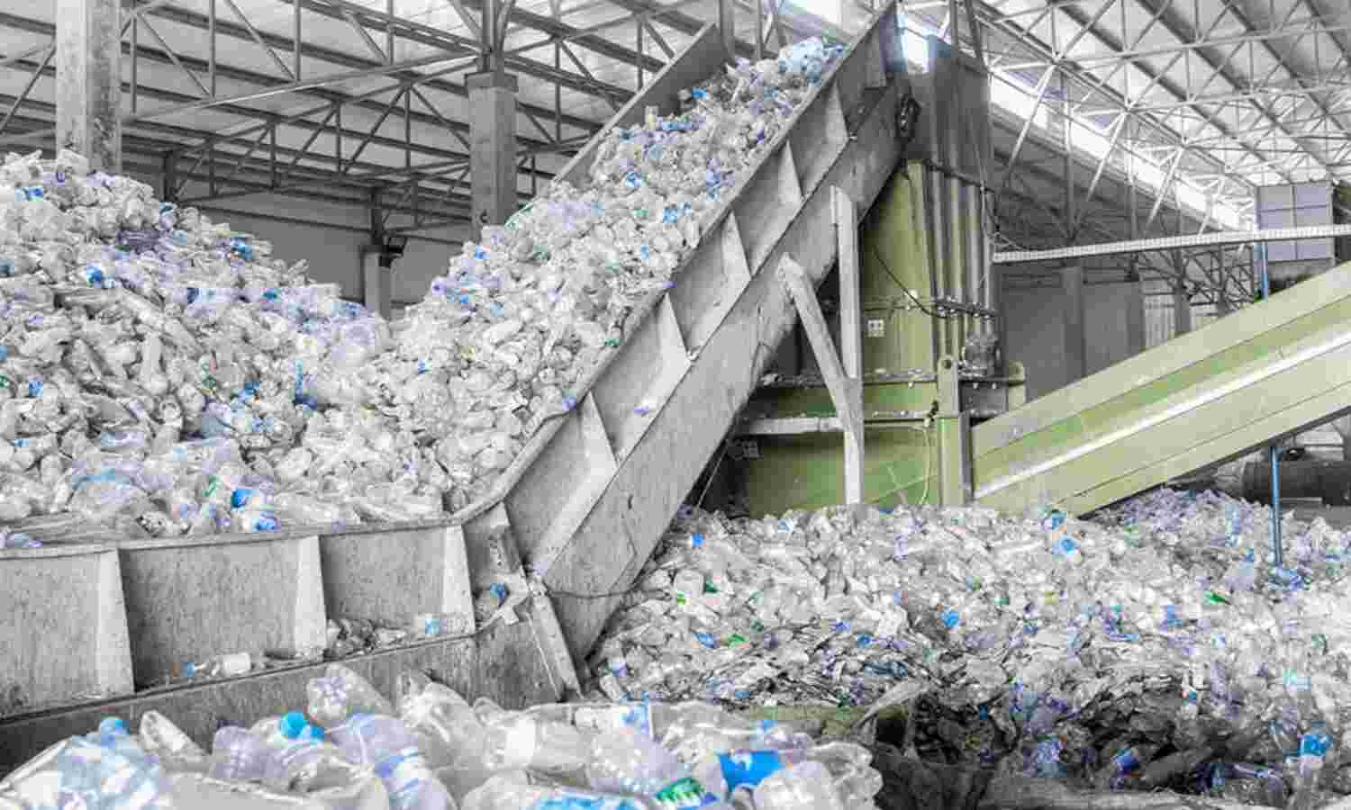
Waste Fr0m Bottle
This bottles are recycled into polyester fleece or caepeting

Slide 11
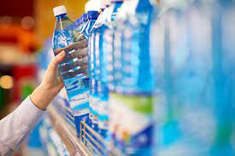
Conclusion
Check the packing Date of Bottle Before Buying
After six Months Bottle start to release chemicals

Slide 12
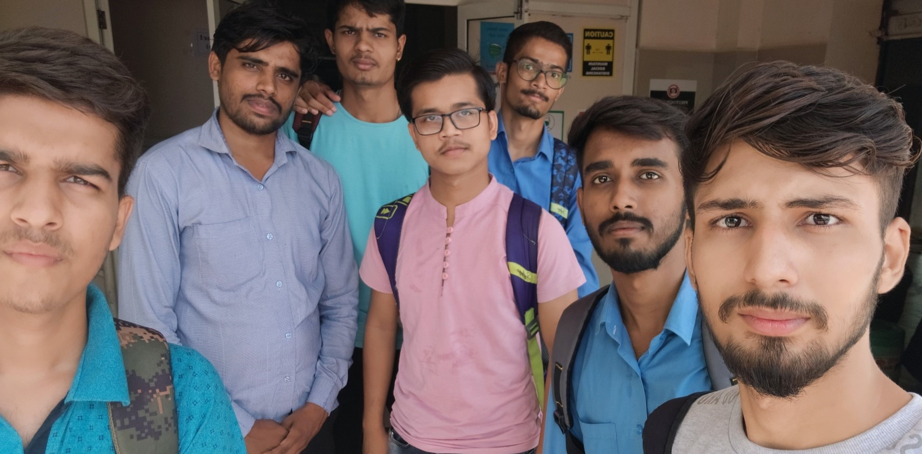
MR.Amit sir
(Our Guide)

Slide 13

T
- Gaurav L. Bhaisare

